Slide 1
Network Protocols
Topic 8A

Slide 2
Learning Outcomes
By the end of this lesson, you should be able to:
Describe the purpose of a network protocol and the layers in the TCP/IP architecture
Describe TCP/IP Application-layer protocols

Slide 3
TCP/IP’s Layered Architecture
Protocols are rules and procedures for communication and behavior
Computers must “speak” the same language and agree on the rules of communication
When a set of protocols works cooperatively it is called a protocol suite (or “protocol stack”)
The most common protocol stack is Transmission Control Protocol/Internet Protocol (TCP/IP)
TCP/IP is composed of more than a dozen protocols operating at different levels of the communication process

Slide 4
TCP/IP’s Layered Architecture
Example of how the layers work together:
You start your Web browser and your home page is http://www.cengage.com
The web browser formats a request for your home page by using the Application layer protocol HTTP
The request looks something like Figure 5-2 (see the following slides)
The unit of information the Application layer works with is simply called “data”
The Application-layer protocol HTTP passes the request down to the Transport-layer protocol (TCP)
TCP adds a header to the request that looks like Figure 5-3 (see the following slides)
The unit of information the Transport layer works with is called a segment
TCP passes the segment to the Internetwork layer protocol (IP)

Slide 5
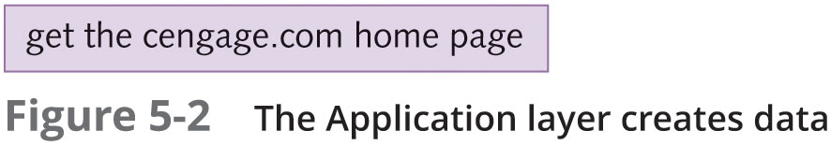
TCP/IP’s Layered Architecture

Slide 6
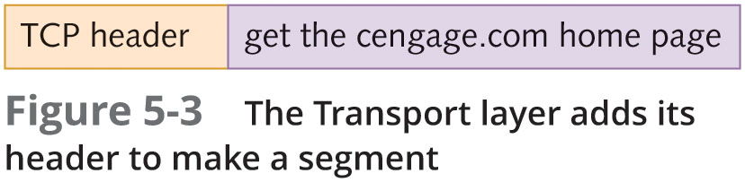
TCP/IP’s Layered Architecture

Slide 7
TCP/IP’s Layered Architecture
Example continued:
IP places its header on the segment (see Figure 5-4 on the following slides)
The unit of information is now called a packet
The packet is passed down to the Network access layer, where the NIC operates
A frame header and trailer are added (see Figure 5-5 on the following slides)
The frame is delivered to the network medium as bits
on its way to the www.cengage.com server
The web server processes it and returns a Web page

Slide 8
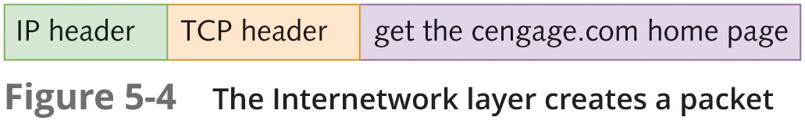
TCP/IP’s Layered Architecture

Slide 9
TCP/IP’s Layered Architecture

Slide 10
Application-Layer Protocols
The Application layer provides network services to user applications that access network resources
With most Application layer protocols, both a client and a server version exist
The Application layer provides these functions:
Access by applications to network services
Client/server data access
Name resolution
Dynamic address assignment
Authentication/user logon
Data formatting and translation

Slide 11
HTTP: Protocol of the World Wide Web
Originally, HTTPs main purpose was to transfer static web pages written in HTML
Now, it is used for general file transfer and downloading/displaying multimedia files
It is also used for delivering scripts for animated and interactive Web pages
HTTP uses TCP as its Transport-layer protocol
The default TCP port number is 80

Slide 12
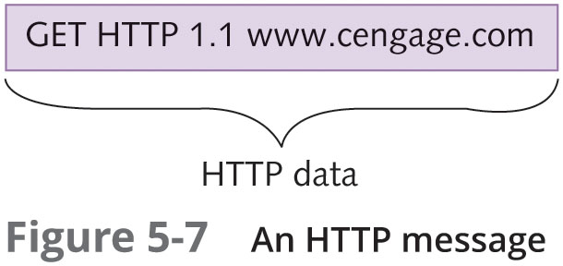
HTTP: Protocol of the World Wide Web

Slide 13
E-Mail Protocols: SMTP, POP3 AND IMAP4
Simple Mail Transfer Protocol (SMTP) is the standard protocol for sending email over the Internet
SMTP uses TCP port 25
Post Office Protocol version 3 (POP3) is used to download incoming messages from e-mail servers to local desktops
POP3 uses TCP port 110
Internet Message Access Protocol version 4 (IMAP4) is used to manage email messages locally yet stores them on a server
IMAP4 uses TCP port 143

Slide 14
FTP and TFTP
File Transfer Protocol (FTP) is a client/server protocol used to transfer files and manage files across a network
FTP uses TCP ports 20 and 21
Port 20 is for transferring file data
Port 21 is for users sending control commands
FTP is not a secure protocol
Trivial File Transfer Protocol (TFTP) is a simple protocol for transferring files
TFTP has little file management capability
It uses UDP port 69

Slide 15
Server Message Block
Server Message Block (SMB) is the protocol Windows file and printer services use to share resources between Windows computers
SMB is used almost exclusively in a private network instead of across the Internet
It uses TCP port 445
Linux and Mac OS X also support SMB with their own variations

Slide 16
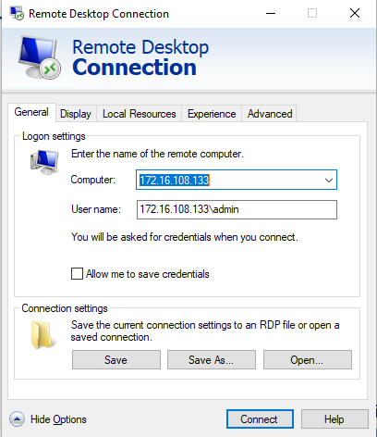
Remote Desktop Protocol
Remote Desktop Protocol (RDP) is used to access a Windows computer remotely by using the Windows GUI
RDP is used to run Windows applications remotely and network administrators use it to manage Windows workstations and servers remotely
RDP uses TCP port 3389

Slide 17
Telnet and SSH
Telnet and Secure Shell (SSH) are used to connect to a device across a network via a command-line interface
Network administrators might use Telnet or SSH to connect to a managed switch or router
Telnet uses TCP port 23
Is not a secure protocol
SSH uses TCP port 22
Provides an encrypted channel between the client and server

Slide 18
Simple Network Management Protocol
Simple Network Management Protocol (SNMP) is used to monitor and manage network devices and gather statistics about network traffic
Software agents are installed on devices you want to monitor and manage
Agents collect data and transfer it to a network management station for storage and analysis
SNMP operates on UDP ports 161 and 162

Slide 19
Dynamic Host Configuration Protocol
A drawback of using TCP/IP in a large network is keeping track of assigned addresses and to which machine they are assigned
Dynamic Host Configuration Protocol (DHCP) is used to automatically assign IP addresses as needed
When a computer is turned on, it requests an IP address from a server that is configured as a DHCP server
The request is sent in the form of a broadcast message
The server assigns an address for a specific amount of time (called a lease)

Slide 20
Dynamic Host Configuration Protocol
DHCP Server
A DHCP server is composed of the following:
IP address scope – a range of IP addresses the server leases to clients
Scope options – IP settings such as default gateway, DNS servers, a domain name, and other options
Reservations – an IP address tied to a particular MAC address
Exclusions – one or more IP addresses excluded from the IP address scope
DHCP Server service – runs in the background and listens on UDP port 69 for IP address requests

Slide 21
Dynamic Host Configuration Protocol
DHCP Server (continued)
After an address is leased
A record of the lease is stored in a database, including a lease expiration time
When 50% of the lease time has elapsed, the computer attempts to renew the lease from the same DHCP server that originally responded
If there’s no response, the computer waits until lease is 87.5% expired, a broadcast DHCP renewal request is then sent
If there’s no response when the lease expires, the computer broadcasts a DCHP request for a new IP address
If no DHCP server responds, one of two things happens:
TCP/IP stops functioning
The computer assigns itself an address from a special range of addresses beginning with 169.254. (Automatic Private IP Addressing or APIPA)

Slide 22
Dynamic Host Configuration Protocol
DHCP Server (continued)
Benefit of using DHCP
Computers can easily be moved and request new IP configuration from a DHCP server on the new segment
DHCP uses UDP
DHCP servers are usually located on the same network and DHCP messages are short

Slide 23
Dynamic Host Configuration Protocol
DHCP Client
Broadcast packets used by the DHCP process:
DHCPDiscover – the client announces to the network that it’s looking for a DHCP server
DHCPOffer – the server replies and offers the client an IP address for lease
DHCPRequest – the client wants the offered IP address
DHCPAck – the server acknowledges the transaction and the client can now use the IP address
You should consider assigning static addresses (that don’t change) to certain devices, such as network printers and servers
You can configure reservation addresses on the DHCP server

Slide 24
Dynamic Host Configuration Protocol
DHCP Client (continued)
DHCP client software runs as a service that starts when the computer starts
You can stop, start, restart, and view status in Windows by double-clicking DHCP Client in the Services control panel
This service runs even if your IP address is assigned statically
To prevent it from running, disable it in the DHCP Client Properties dialog box or from the command line with the net command

Slide 25
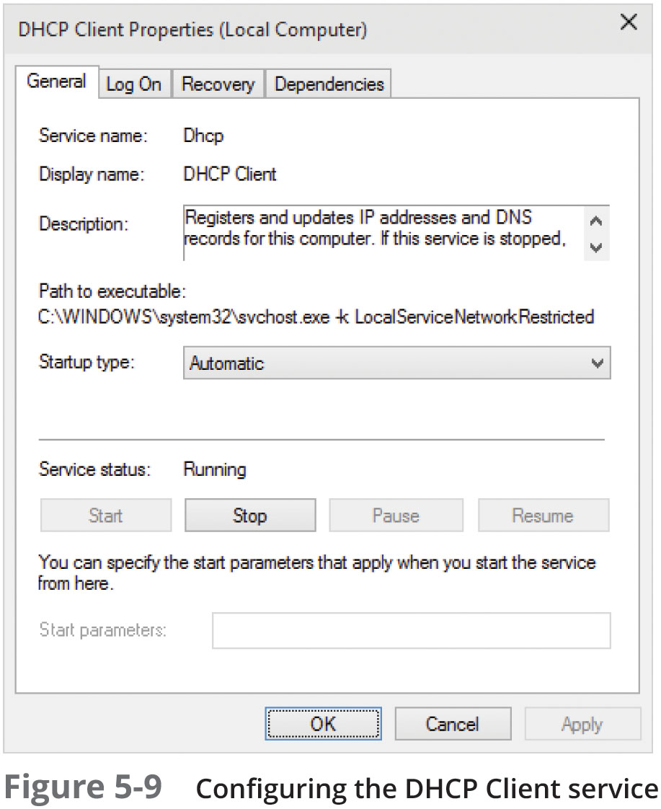
Dynamic Host Configuration Protocol

Slide 26
Domain Name System
Domain Name System (DNS) is a name-to-address resolution protocol that keeps a list of computer names and their IP addresses
Using DNS, a user can use a computer’s name instead of using it’s IP address
Example:
When you enter www.cengage.com in your Web browser, the DNS Client service contacts the DNS server specified in your OS’s IP configuration and requests that the name be resolved to an IP address
Once the IP address for the website is returned, your computer can contact the Web server to request a Web page
DNS uses UDP because DNS messages usually consist of a single packet of data

Slide 27
Domain Name System
DNS is organized as a treelike hierarchy
When you put all the names of a branch together, separated by periods, you have the fully qualified domain name (FQDN)
Top-level domains are organized into categories such as commercial (.com), nonprofit organizations (.org), government (.gov) or country of origin indicated by a two-letter code
Second-level domains are usually the name of a company or institution
The subdomain level is optional and can consist of names separated by a period
The host level represents individual computers hosting network services
For example, in www.books.tomsho.com:
com is the top-level domain name, tomsho is the second-level domain, books is the subdomain, and www is the hostname

Slide 28
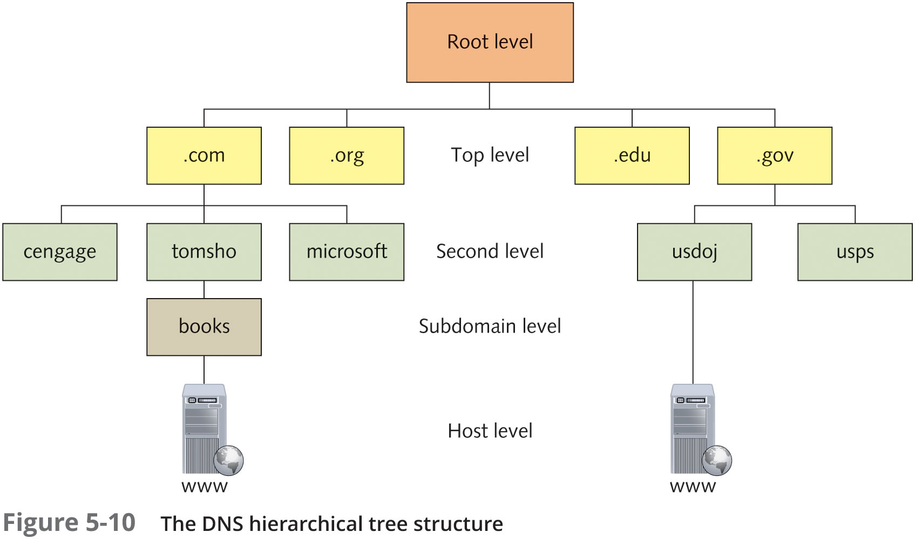
Domain Name System

Slide 29
Domain Name System
When a DNS server is installed, the administrator creates one or more domain names or zones
A zone is named by using the second-level and top-level domain names and the subdomain
A DNS server database contains a list of IP addresses that point to root servers
These servers supply addresses of top-level domain servers
DNS clients in most OSs maintain a DNS cache, called a resolver cache
This cache stores name and IP address pairs and other data for names that have been resolved recently

Slide 30
Domain Name System
DNS Client
The DNS client is responsible for communicating with a DNS server to resolve computer and domain names to IP addresses
The DNS client is referred to as a “resolver”
An OS must be configured to use DNS and needs at least one address of a DNS server that it can query
In Windows, the first DNS server configured is called the preferred DNS server and the second one is the alternate DNS server
DNS servers require a domain name in addition to a computer name
In Windows, the default domain appended to DNS lookups is called the “primary DNS suffix”
Windows supports Dynamic DNS (DDNS), which allows computers and other devices to contact their primary DNS server whenever their name or address changes

Slide 31
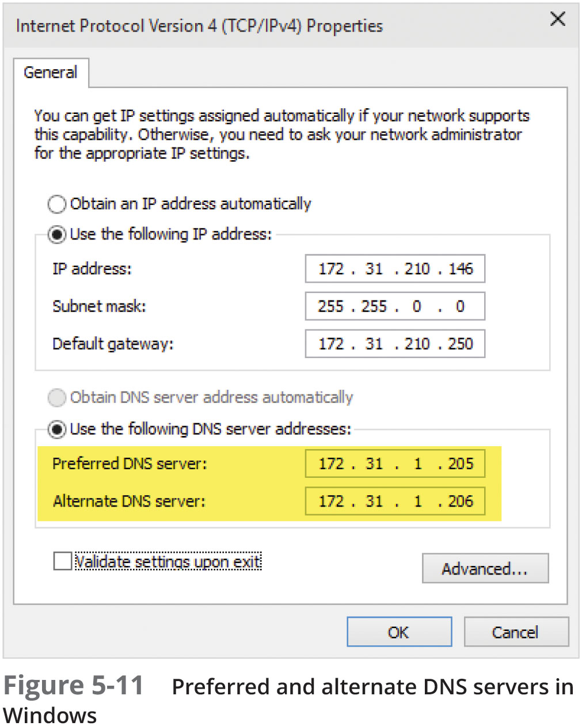
Domain Name System

Slide 32
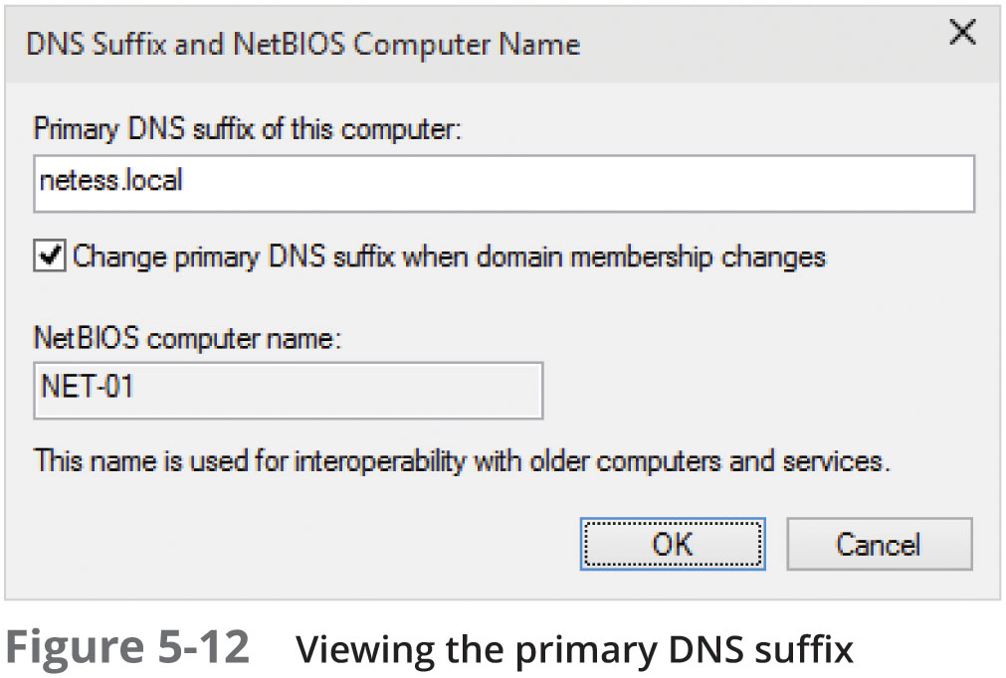
Domain Name System

Slide 33
Domain Name System
DNS Server
DNS servers are composed of the following:
DNS zones – a database of primarily hostname and IP address pairs
Resource records – the data contained in a zone
Cache – results of queries are cached so that if the same query occurs again, the local DNS server can respond without having to contact another server
Root hints – file containing a list of all IP addresses of Internet root servers
DNS Server service – runs in the background and listens for DNS queries on UDP port 53
DNS servers can be configured with no zones at all
This is a configuration called a “caching-only server”

Slide 34
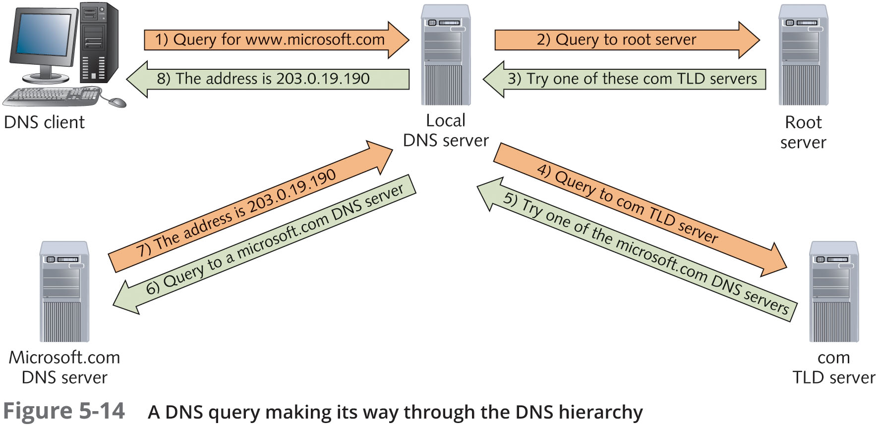
Domain Name System

Slide 35
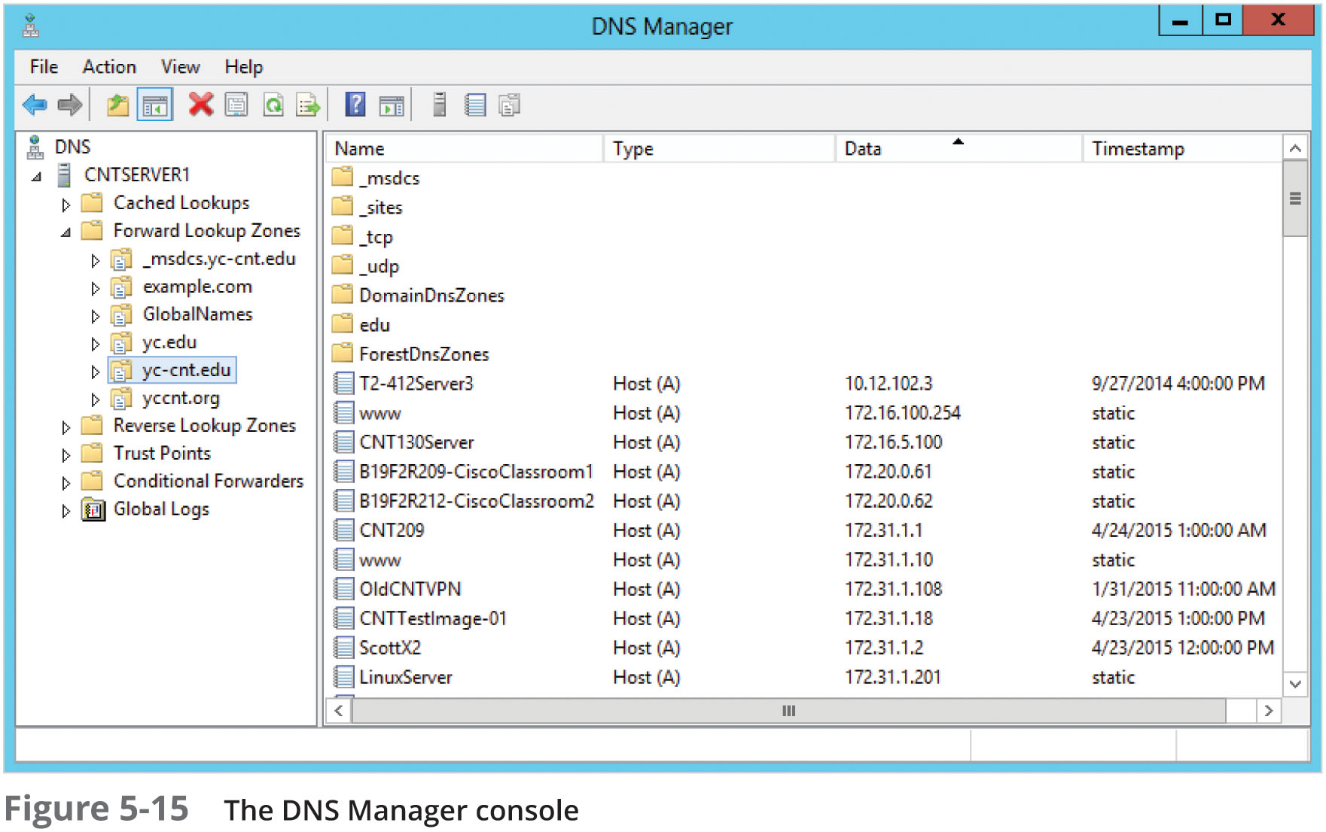
Domain Name System

Slide 36
Summary
TCP/IP is the main protocol suite used in networks
TCP/IP takes a layered approach and is organized in four layers
The Application layer consists of protocols such as HTTP and DNS and provides an interface for applications to access network services
Other commonly used Application-layer protocols include:
Protocols | TCP | Protocols | UDP
FTP | 20 & 21 | DNS | 53
SSH | 22 | TFTP | 69
Telnet | 23 | SNMP | 161
SMTP | 25 | SNMP | 162
HTTP/HTTPS | 80 / 443 | SMB | 445
POP3 | 110
IMAP4 | 143
RDP | 3389

